Slide 1
Zabbix Authenticates User
via Keycloak
Procedure

Slide 2
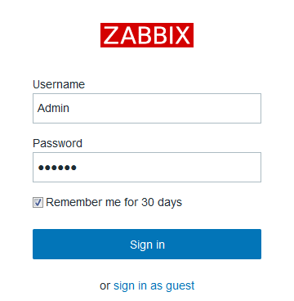
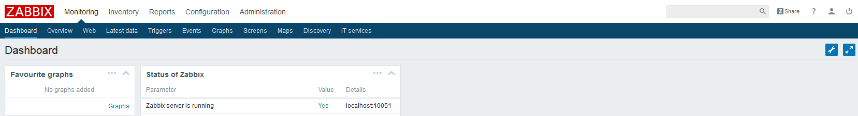
1.When USERs First Login into Zabbix, the default authentication-[Internal ] will be used

Slide 3
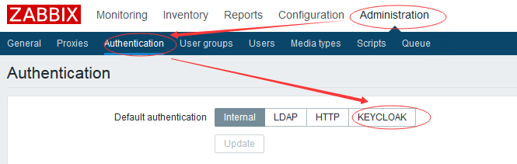
2.When USER want to change the authentication method .
Click Administration → Authentication
Then the KEYCLOAK option will be showed as below.

Slide 4
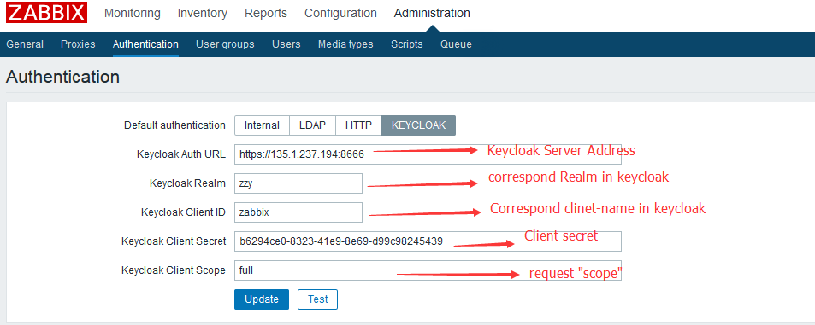
3.USERs change authentication method to KEYCLOAK.
Keycloak Auth URL | Based on this address, to AUTH-User, Exchange-token , Logout…
Keycloak realm | Refer to below
Client id | Refer to below
Client secret | Refer to below
scope | Refer to below

Slide 5
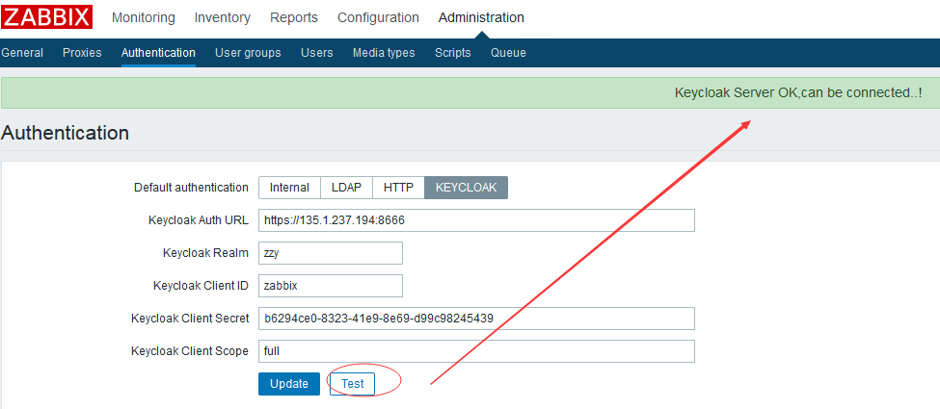
4.TEST button.
TEST button to check the connection between
Zabbix and Keycloak

Slide 6
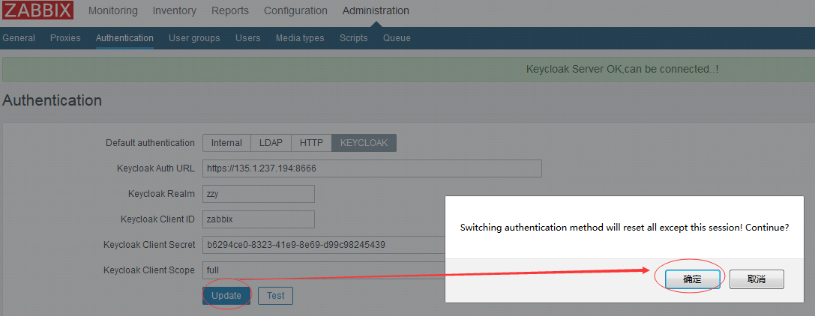
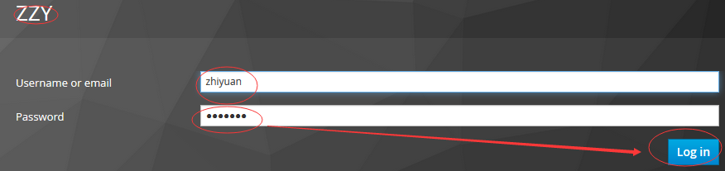
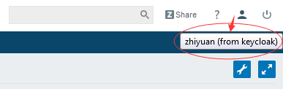
4.UPDATE button.
UPDATE button to make zabbix AUTH user via keycloak
After click “confirm”, zabbix will redirect USER to keycloak,
Input username and password, you can access zabbix and view below info.

Slide 7
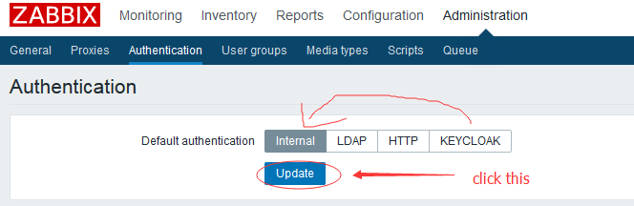
5.Back to Other Authentication methon.

